Slide 1
Final data presentation
Hien Nguyen

Slide 2
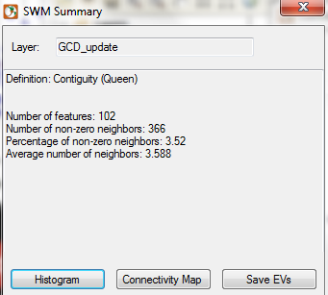
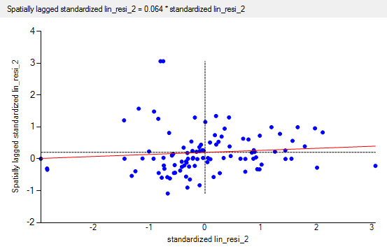
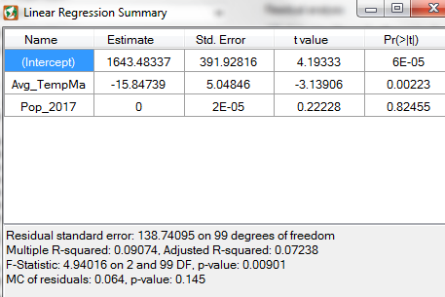
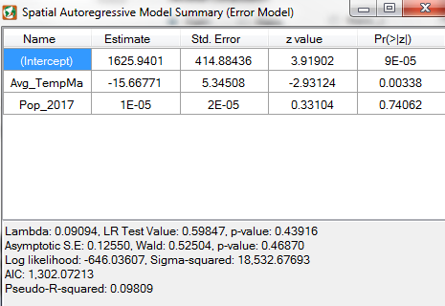
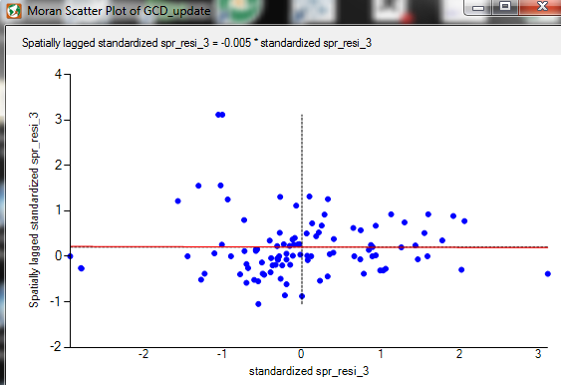
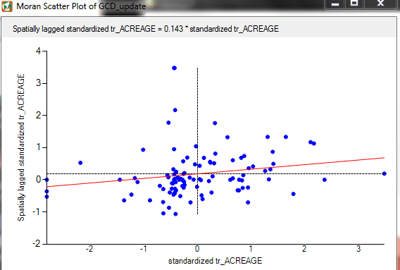
Importance of addressing spatial autocorrelation
MC scatterplot for tr_acreage
The R-squared for the SAR model is higher.
p-value for the linear regression is greater than 0.05
Moran’s I for SAR residuals is also better

Slide 3
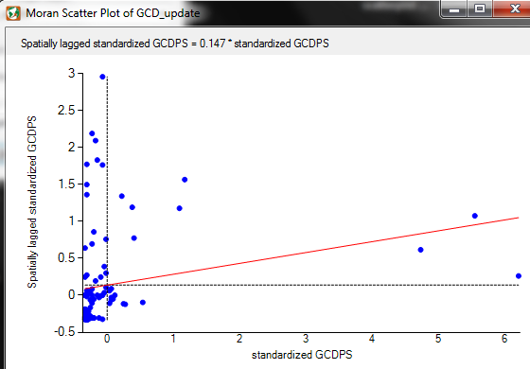
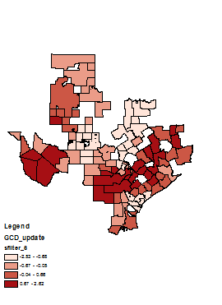
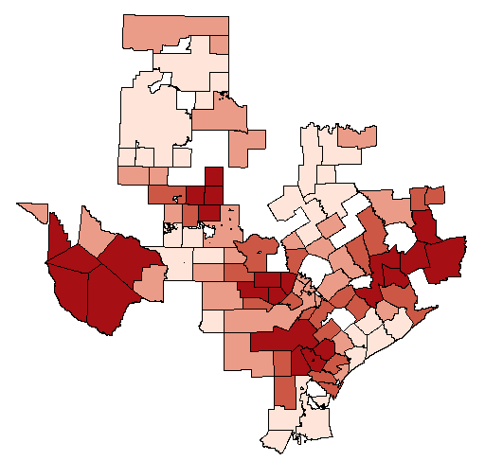
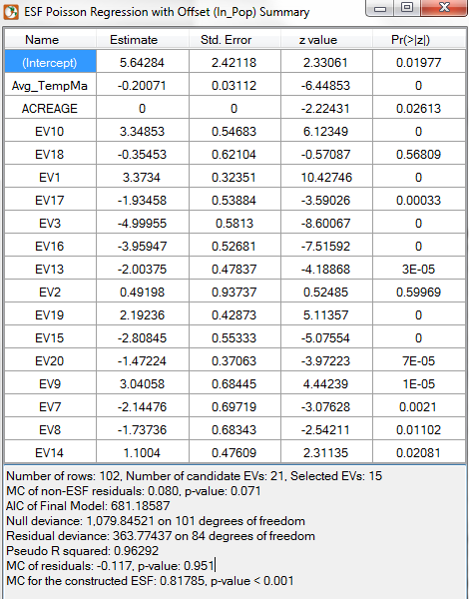
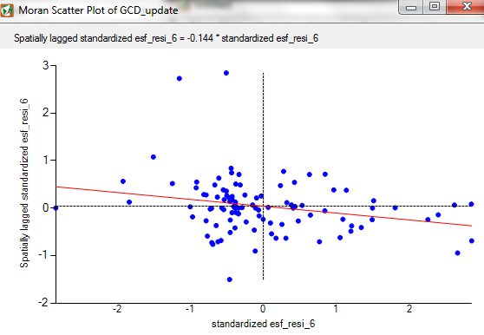
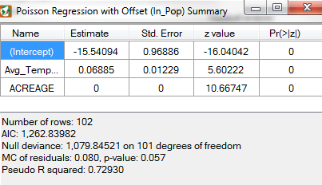
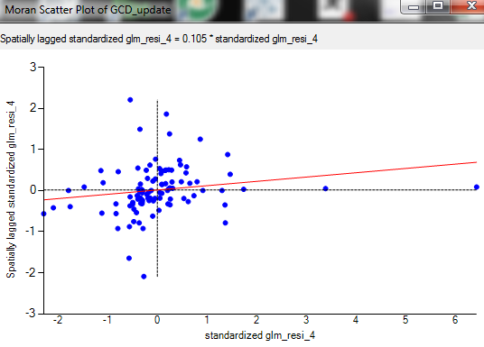
GLM & ESF Poisson model
Response variable: groundwater withdrawals for Public supply (million gallons/day)
Covariate: Avg maximum temperature, GCD acreage
EV10 Local

Slide 4
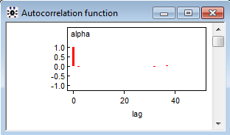
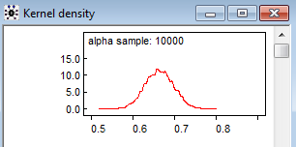

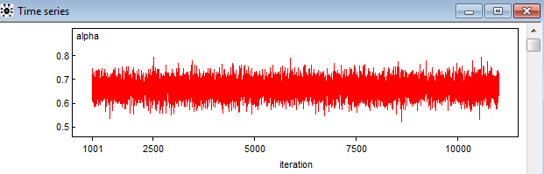
Bayesian model
Estimate the percentage of groundwater withdrawals for public supply w.r.t. total water withdrawals for public supply
The results for history, autocorrelation and
density looks quite good
First 1000 simulations is for burn-in

Slide 5
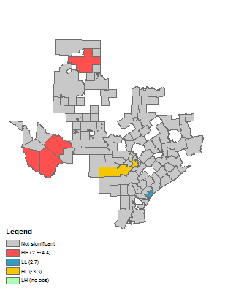
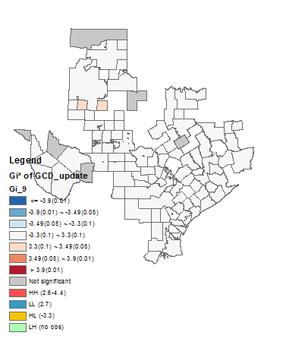
Local spatial analysis for tr_acreage
Local hot and cold spots
Comparison between LISA and Gi*

Slide 6
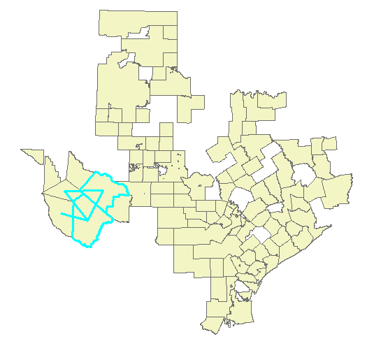
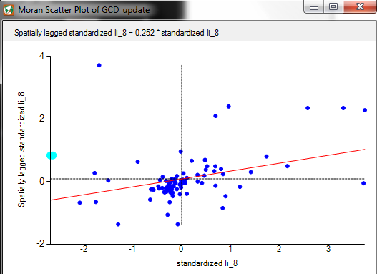
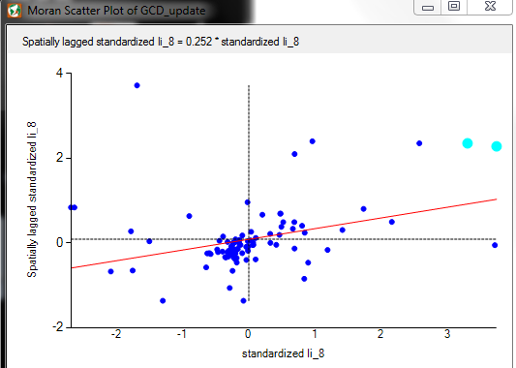
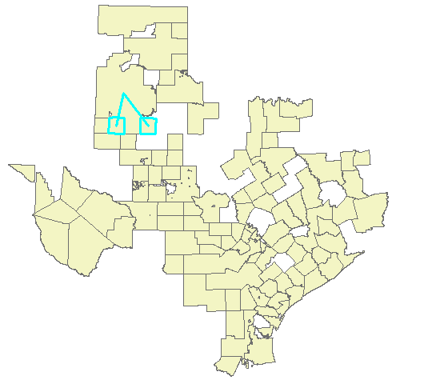
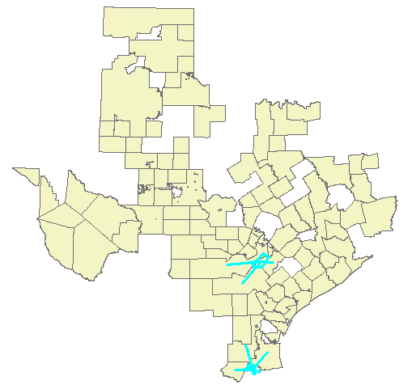
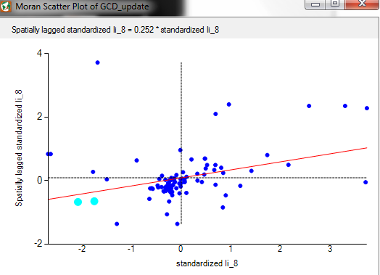
Cold and hot spots for acreage

Slide 7
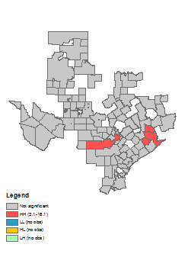
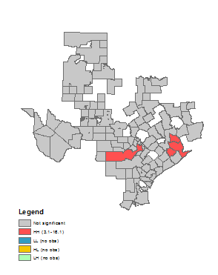
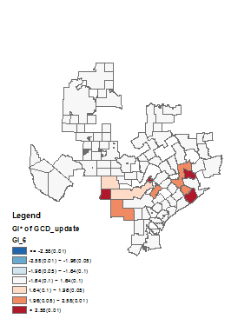
Local spatial analysis for GW for PS

Slide 8
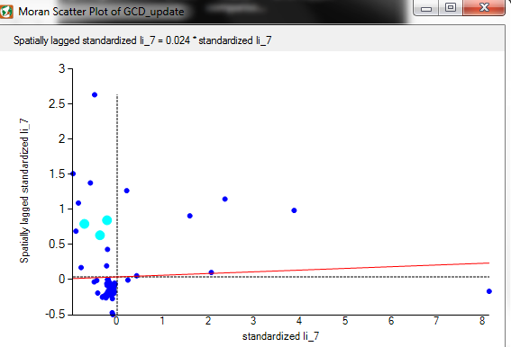
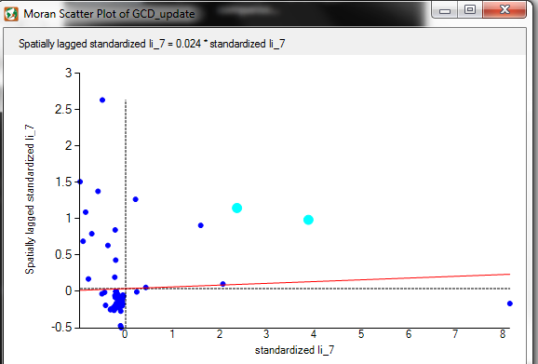
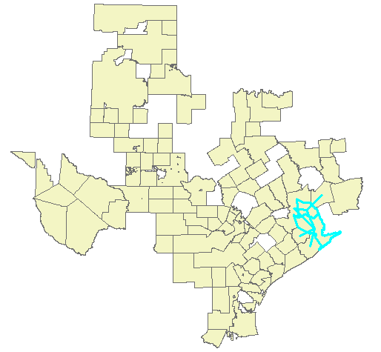
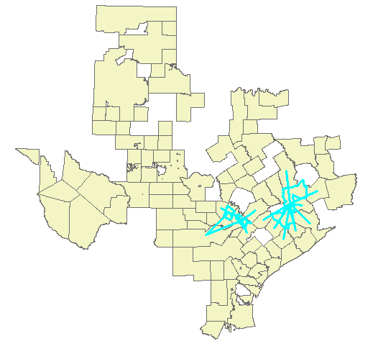
Cold and hot spots for GWPS

Slide 9
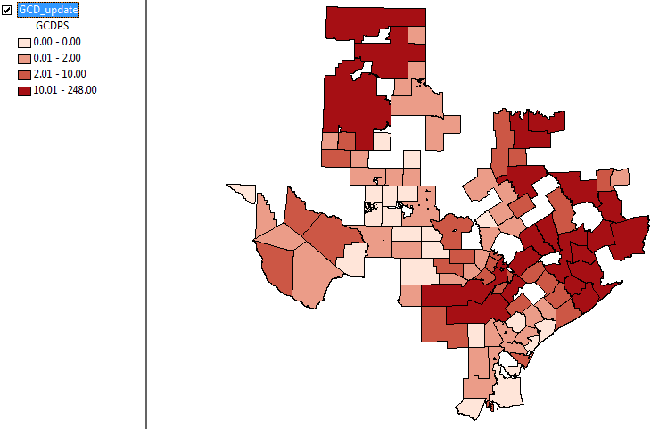
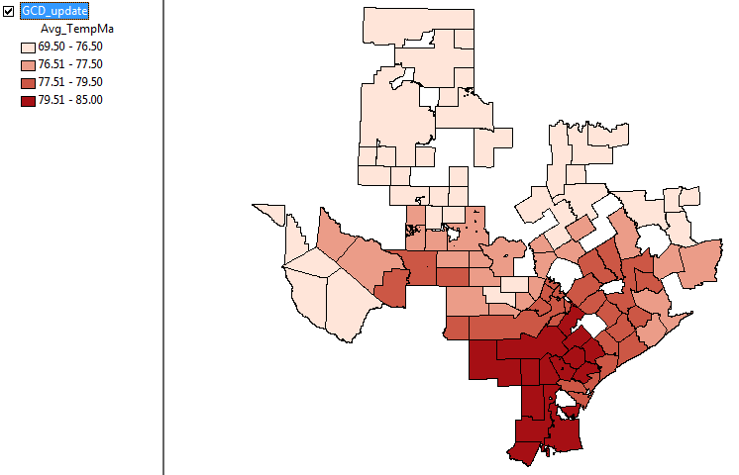
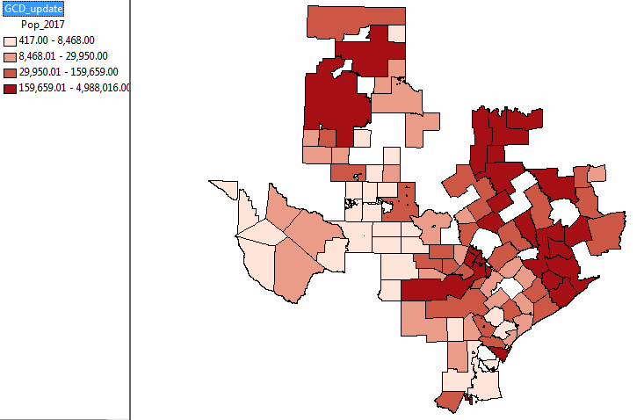
Spatial heterogeneity

Slide 10
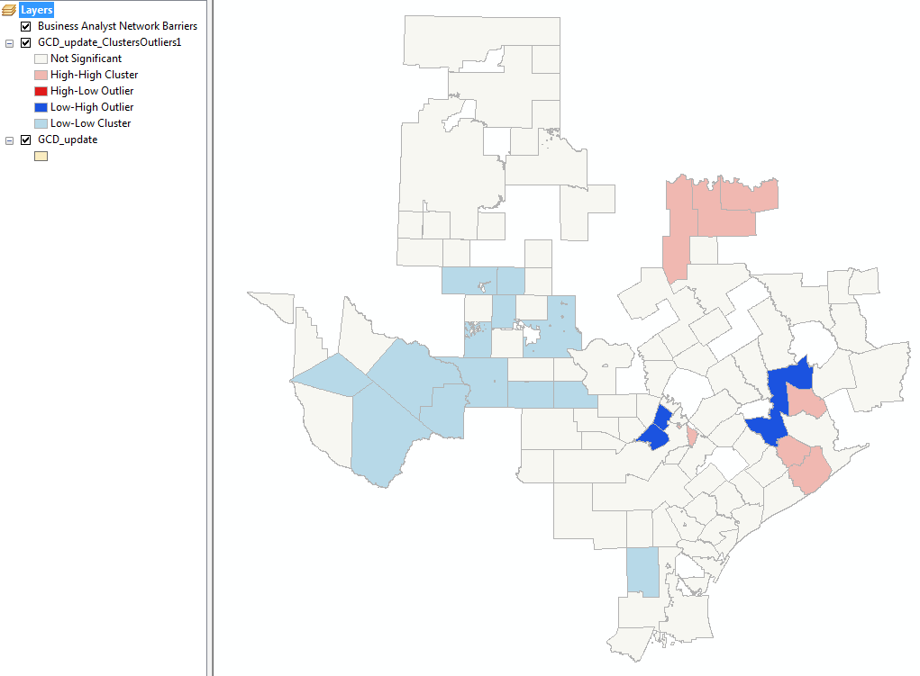
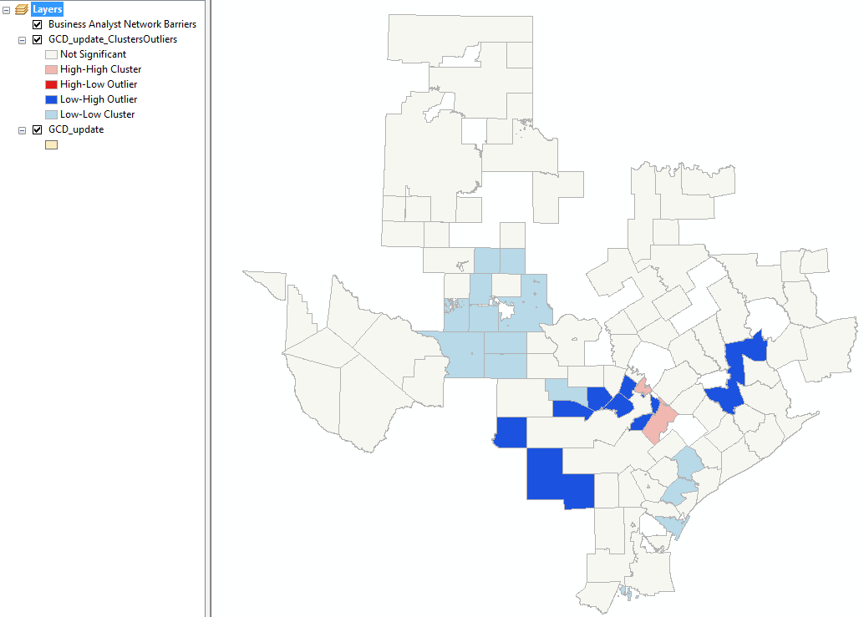
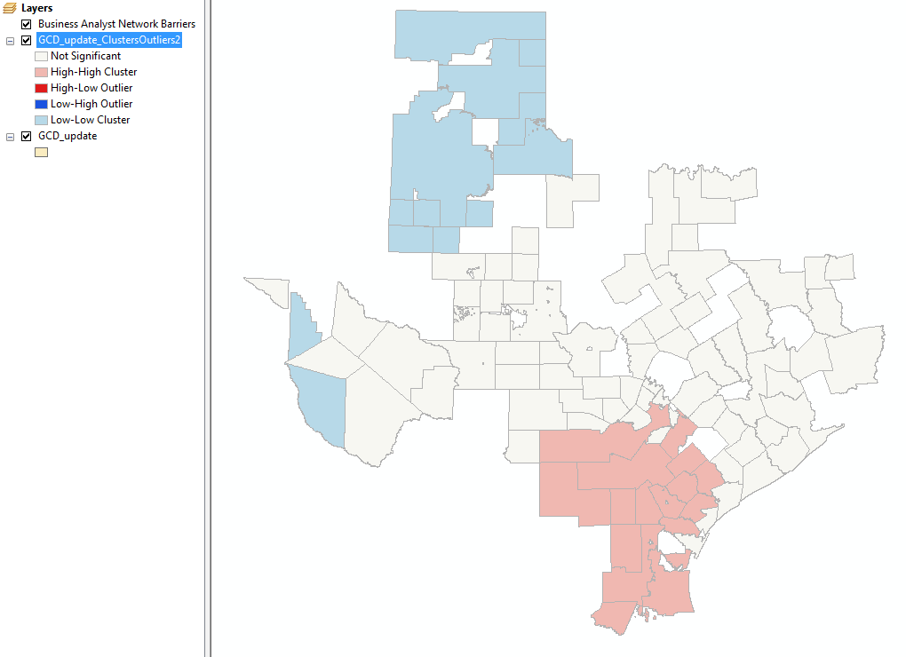
Cluster analysis
Pop
GWPS
Temperature

Slide 11
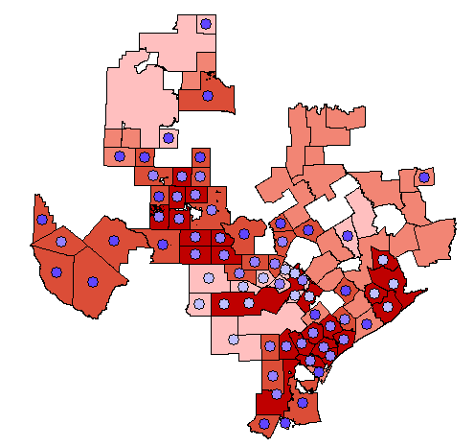
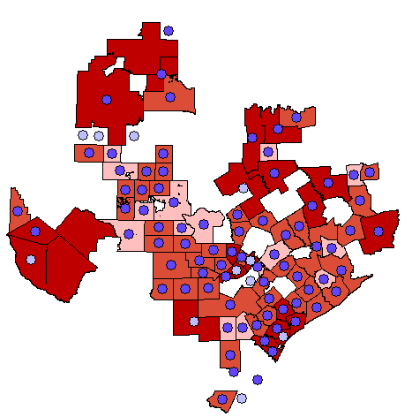
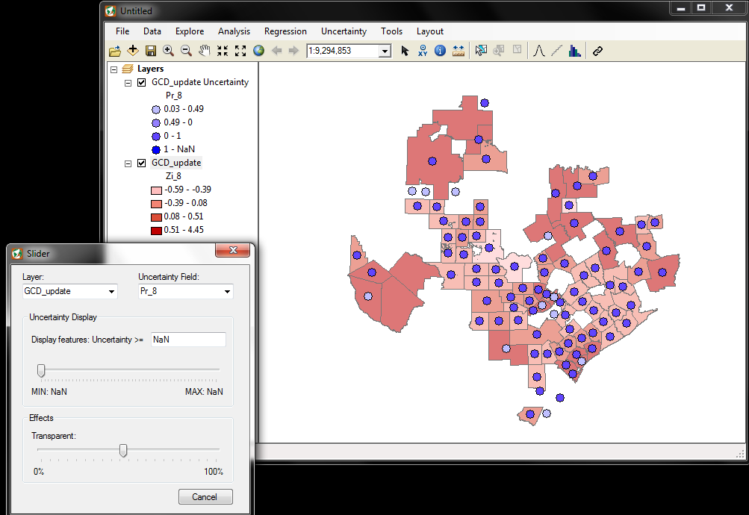
Spatial uncertainty
Some of the high values are associated with low probability so there are still uncertainties in the distribution of high acreage of groundwater conservation districts.
There seems to be less uncertainty
in GWPS
Uncertainty for LISA GWPS
Uncertainty for LISA tr_acreage

Slide 12
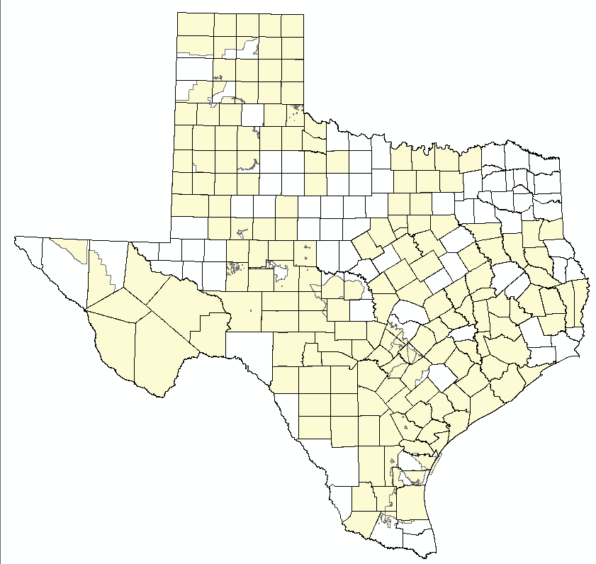
Spatial error
Measurement error: the GCDs boundaries may overlap across the counties so the variables may be overlapping
Specification error: As results of some model are not significant, there might be problem of choosing not really meaningful variable
GCD shp with Texas county boundary

Slide 13
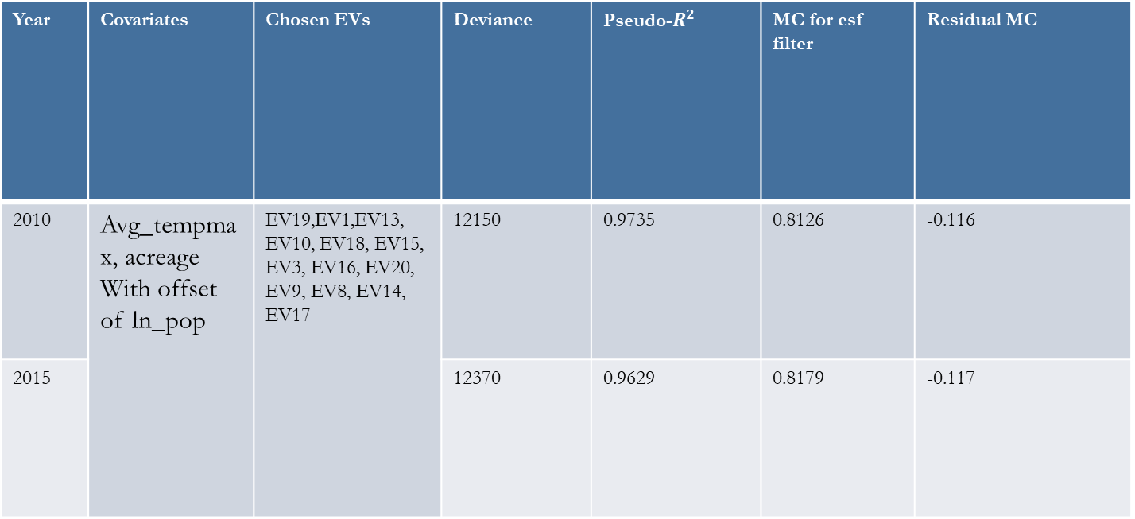
Space time data analysis: ESF
Year | Covariates | Chosen EVs | Deviance | Pseudo-$R^{2}$ | MC for esf filter | Residual MC
2010 | Avg_tempmax, acreage With offset of ln_pop | EV19,EV1,EV13, EV10, EV18, EV15, EV3, EV16, EV20, EV9, EV8, EV14, EV17 | 12150 | 0.9735 | 0.8126 | -0.116
2015 |  |  | 12370 | 0.9629 | 0.8179 | -0.117

Slide 14
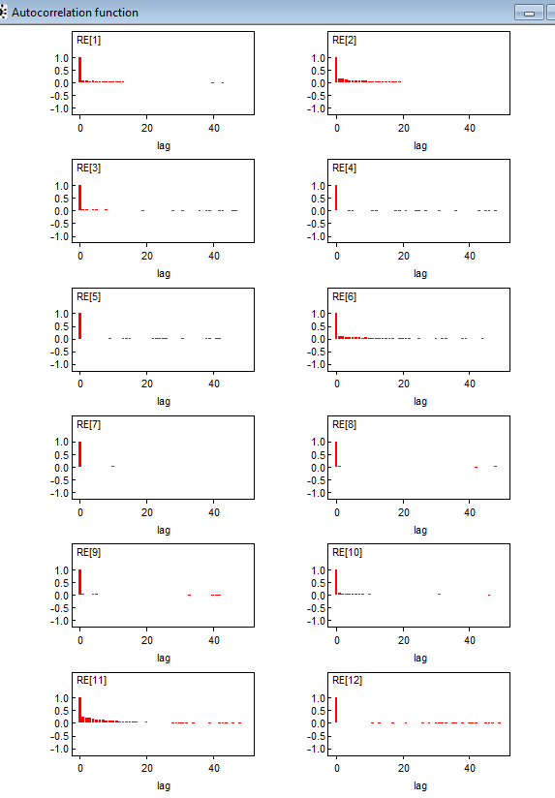
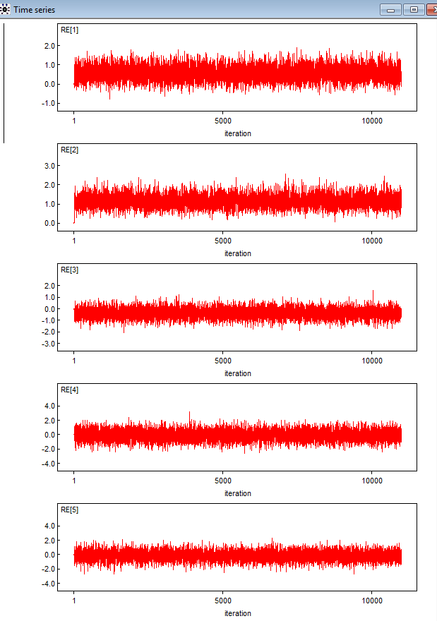
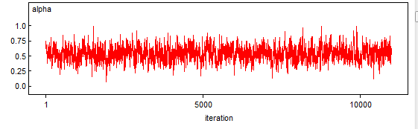
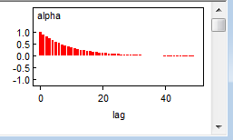
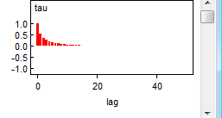
Space time analysis: RE Bayesian

Slide 15
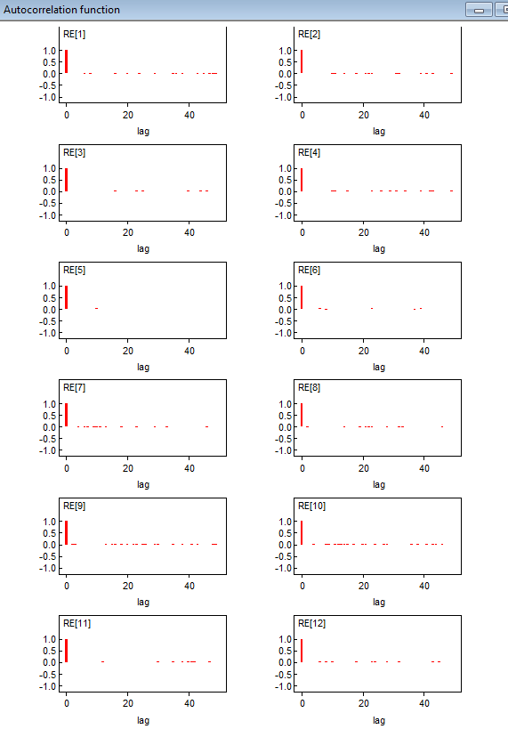
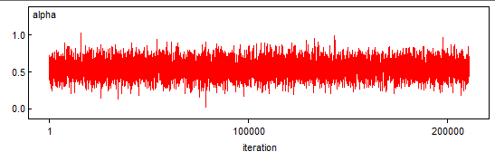
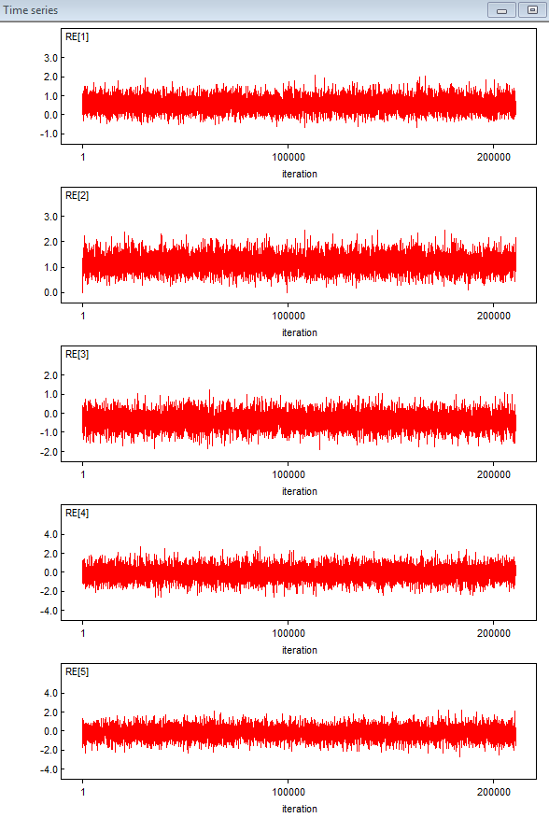



Slide 16

Spatially varying coefficients
R-squared is high at about 0.68
MC of the residual is -0.02
Select both negative and positive eigenvectors since selecting only the positive would not be efficient for the intercept
Intercept: EV8, EV76, EV9, EV6, EV99, EV16, EV1, EV17, EV21
Temp: EV5, EV13, EV7, EV76, EV83, EV1, EV17, EV88
Pop: EV92, EV14, EV94, EV6, EV85, EV10

Slide 17



Map of SVCs
Temp: regional
Intercept: local
population: local

Slide 18



Map of ESFs
EV 1: Regional
Figure 2 EV9 Local
Figure 1 EV 8 Local

Slide 19


Spatial imputation

Slide 20




Slide 21
Implications and conclusions
Spatial autocorrelation is ubiquitous and needs to be accounted for to prevent serious variance inflation problem
Besides spatial autocorrelation, other types of autocorrelation should also be considered for the “best” spatial data analysis
The applicability of spatial imputation depends on what you want to do with the imputed data, it may works for getting an overview of spatial autocorrelation component pattern but not as good for inferential analysis.

Slide 22
Implications and conclusions (cont)
The MESF methods may work well across different spatial structure and data type while conventional and autoregressive models may be harder to be estimate and less accurate in some situations.
The distribution of high values and low values might sometimes be misleading so it is necessary to visualize the uncertainty in the data.

